Slide 1
Sampling Methods & Statistical Analysis Plans
MSc Bioinformatics: Research Methods
11 March 2020
Marc Henrion (facilitator, slides update)
James Chirombo (facilitator, slides update)
Mavuto Mukaka (original slides, SAP, Sampling techniques)
https://github.com/gitMarcH/COM_STA621_2020
mhenrion@mlw.mw

Slide 2
Part A - Sampling methods

Slide 3
Learning Objectives
Aim:
To understand the main types of sampling methods for observational studies.
Learning objectives:
To learn about the importance of thinking about sampling methods.
To understand what are
Convenience and solicited response samples
Probability samples
Simple random sample
Systematic random sample
Stratified random sample
Cluster random sample

Slide 4
Learning Outcomes
Understand a range of sampling methods
Know how common sampling methods can be implemented and contexts in which they are appropriate
Understand the value of probability based sampling

Slide 5
Outline
Definitions
Probability sampling
Non-probability sampling

Slide 6
Definitions
Population is a set of all units in which we are interested.
Typically, there are too many units in a population to consider every one.
If we can examine every single one, we conduct a census.
Sample is a subset of the population.

Slide 7
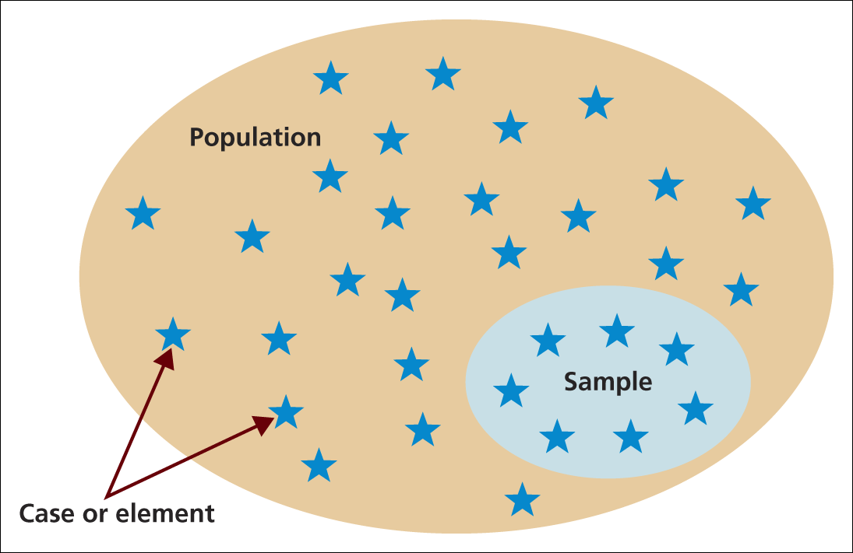
Population, sample and individual cases
Source: Saunders et al. (2009)

Slide 8
The sample must be:
1. representative of the population;
2. appropriately sized
3. unbiased
4. random (selections occur by chance)
The above criteria are interrelated.

Slide 9
n is large enough to provide a reliable
answer to the question
- too small n unreliable, waste of time
too many n waste of time, money &
other resources, ethics

Slide 10
Definitions
Target Population :
The population to be studied/ to which the investigator wants to generalize the results
Sampling frame :
List of all the sampling units from which sample is drawn
Sampling Unit :
Smallest unit from which sample can be selected
Sampling scheme :
Method of selecting sampling units from sampling frame

Slide 11
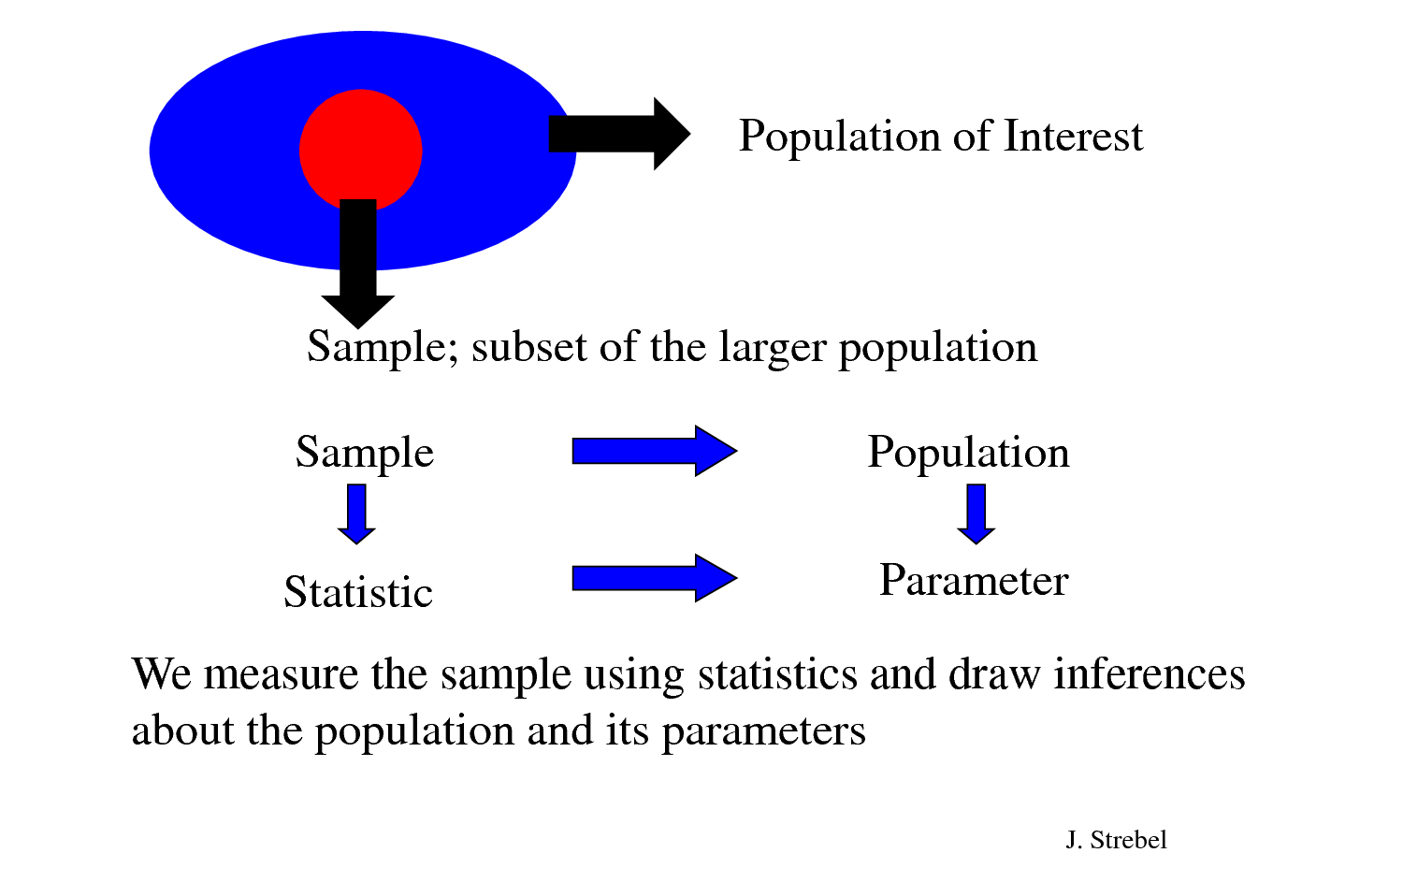
Sampling
Sampling is the process or technique of selecting a sample of appropriate characteristics and adequate size.

Slide 12
Why sampling?
Less costs
Less field time
More accuracy, i.e. Can Do A Better Job of Data Collection
When it’s impossible to study the whole population

Slide 13
Sampling process
The sampling process comprises several stages:
Defining the population of concern
Specifying a sampling frame
Specifying a sampling method for selecting items or events from the frame
Determining the sample size
Implementing the sampling plan
Sampling and data collecting

Slide 14
Methods of Sampling
Probability Sampling
each member of the population has an equal chance of being selected
Non-Probability Sampling
some people have a greater, but unknown, chance than others of selection

Slide 15
Methods of Sampling
1. Probability
1.1 Simple random
1.2 Systematic
2. Non-probability
2.1 Convenience
2.4 Snowball
1.3 Stratified
1.4 Cluster
1.5 Multi-stage
2.2 Purposive
2.3 Quota

Slide 16

1.1 Simple Random Sampling
Objective: To select n units out of N such that each person has an equal chance of being selected.
Procedure: Use a table of random numbers, a computer random number generator, or a mechanical device to select the sample.
N = 50
n = 10
Sampling Frame
1 2 3 4 5 6 7 8 9 10
11 12 13 14 15 16 17 18 19 20
21 22 23 24 25 26 27 28 29 30
31 32 33 34 35 36 37 38 39 40
41 42 43 44 45 46 47 48 49 50
1 2
3 4
5 ….. 49 50
1 2 3 4 5 6 7 8 9 10
11 12 13 14 15 16 17 18 19 20
21 22 23 24 25 26 27 28 29 30
31 32 33 34 35 36 37 38 39 40
41 42 43 44 45 46 47 48 49 50

Slide 17
1.2 Systematic Random Sampling
Procedure:
1. Number the units in the population from 1 to N;
2. Decide on the n (sample size) that you want or need;
3. Calculate the interval size k = N/n;
4. Randomly select an integer between 1 to k
5. Take every k^{th} unit

Slide 18
1
13
25
37
49
2
14
26
38
50
N = 60
n = 10
Interval k = 60/10 = 6
Random = 2nd
3
15
27
39
51
4
16
28
40
52
5
17
29
41
53
6
18
30
42
54
7
19
31
43
55
Taking sample :
2, 8, 14, 20, 26
32, 38, 44, 50, 56
8
20
32
44
56
9
21
33
45
57
10
22
34
46
58
11
23
35
47
59
12
24
36
48
60

Slide 19
1.3 Stratified Random Sampling
Procedure:
1. Population is divided into strata, or groups;
2. Randomly select members of each stratum (the number selected is proportional to the stratum’s size)
A major objective of stratified sampling is to increase precision without increasing cost.

Slide 20
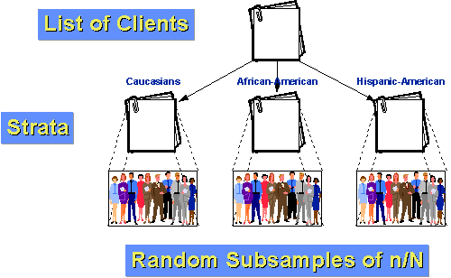
The elements within a stratum should be as homogeneous as possible, but the elements in different strata should be as heterogeneous as possible

Slide 21
1.4 Cluster Random Sampling
Procedure:
Divide population into clusters (usually geographic boundaries)
2. Randomly sample clusters
3. Measure all units within sampled clusters
1 2 3 4 5 6 7 8 9 10
1 2 3 4 5 6 7 8 9 10
28 29 30 31 32 33 34
28 29 30 31 32 33 34
35 36 37 38 39 40 41 42 43 44 45
11 12 13 14 15 16
·
17 18 19 20 21 22 23 24 25 26 27
46 47 48 49 50
46 47 48 49 50

Slide 22
1.5 Multi-stage Random Sampling
Combine of the four basic sampling methods: simple, stratified, systematic and cluster in a variety of useful ways that help us address our sampling needs in the most efficient and effective manner possible.
Complex form of cluster sampling in which two or more levels of units are embedded one in the other.

Slide 23
Procedure:
1. First stage, random number of districts chosen in all
states.
2. Followed by random number of villages.
3. Then third stage units will be houses.
1 2 3 4 5 6 7 8
1 2 3 4 5 6 7 8
1 2 3 4 5 6 7 8 9 10
11 12 13 14 15 16 17 18 19 20
9 10 11 12 13 14 15 16 17 18 19 20
9 10 11 12 13 14 15 16 17 18 19 20
·
21 22 23 24 25 26 27 28 29 30
·
31 32 33 34
31 32 33 34
31 32 33 34 35 36 37 38 39 40
41 42 43 44 45 46 47 48 49 50
35 36 37 38 39 40 41 42 43 44 45 46 47 48 49 50
35 36 37 38 39 40 41 42 43 44 45 46 47 48 49 50

Slide 24
Multistage random sampling technique
Eastern Region of Malawi
Selected all districts
1
2
3
4
5
Districts
6
7
8
9
10
Randomly selected subdistricts 30% of each district by simple random
6
5
4
4
4
Sub-districts
3
2
2
2
2
Randomly Selected one village of each sub-district
6
5
4
4
4
Villages
3
2
2
2
2
Randomly selected number of household for interview by simple random sampling
301
167
154
138
65
Households
86
16
76
66
56

Slide 25
Community-Based Approach For Prevention And Control of Dengue Haemorrhagic Fever in Lilongwe District, Malawi
Lilongwe East
sub-district
(experimental group)
Village 5
(all households about 190)
Sample
Lilongwe District
Lilongwe West
sub-district
(comparison group)
Village 1
(all households about 238)
the incidence of DHF was 130.57 per 100,000 population

Slide 26
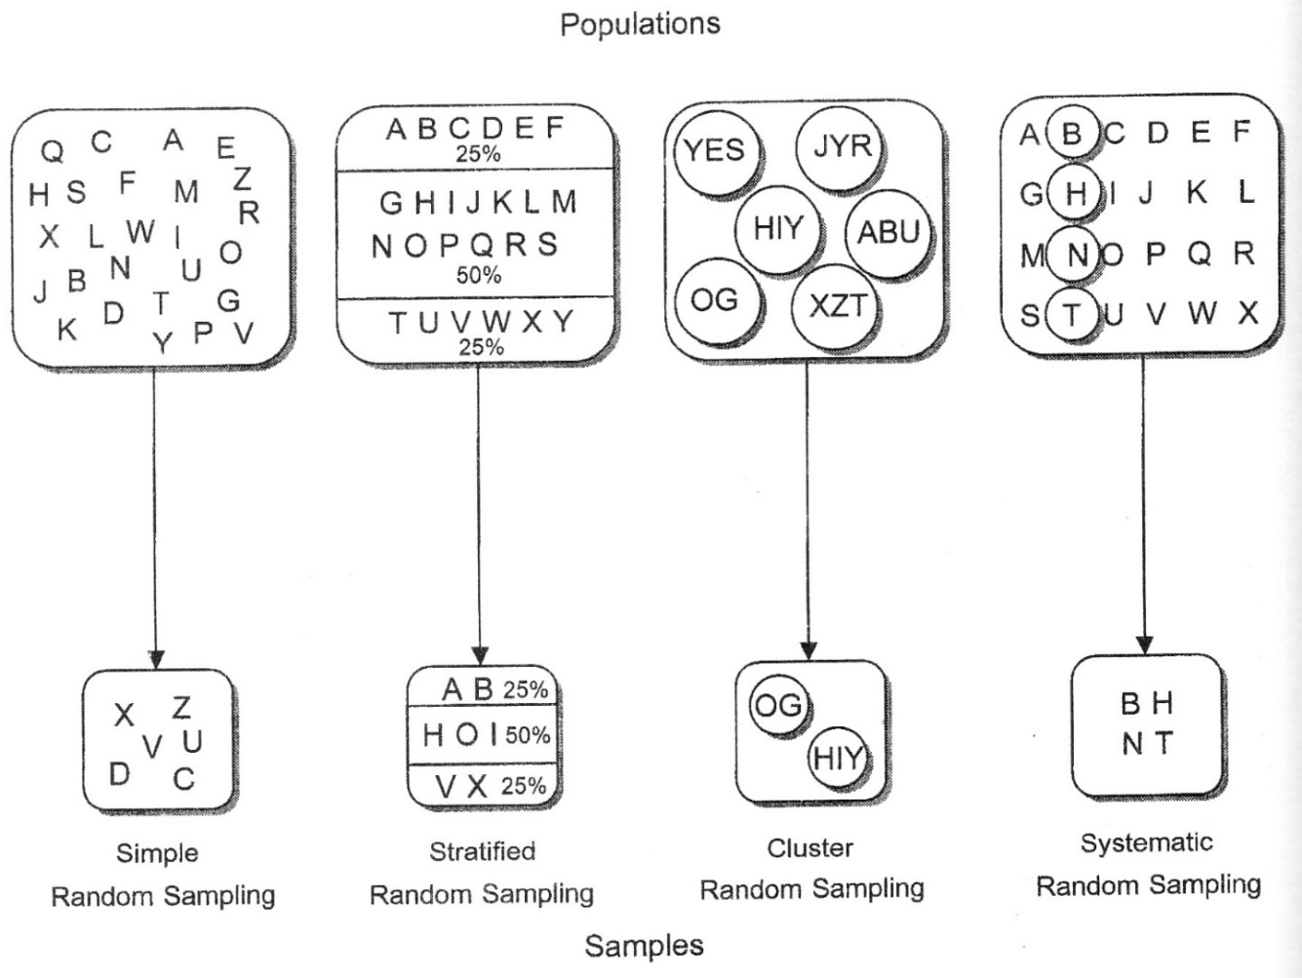

Slide 27
Probability Sampling
Advantages
Generally will produce more representative samples
Avoid conscious bias
Disadvantages
requires a sampling frame, which is not always available
Often takes longer and cost more to select

Slide 28
2.1 Convenience Sampling
Attempts to obtain a sample of convenient elements.
Often, respondents are selected because they happen to be in the right place at the right time. (person on the street, volunteers)
Problem : we have no evidence that these samples are representative of the populations we are interested in generalizing to.
If you performed convenience sampling from people walking past you in the main street at the Victory monument, which groups of the population would be over-represented or under-represented?

Slide 29
2.2 Purposive Sampling
Enables you to use your judgment to select cases that will best enable you to answer your research question(s) and to meet your objectives.
It is very useful technique for situations where:
- you need to reach a targeted sample quickly
- sampling for proportionality is not the primary concern

Slide 30
2.3 Quota Sampling
Select people non-randomly according to some fixed quota.
Decide on characteristic of which sample is to be representative, e.g. age
Find out distribution of this variable in population and set quota accordingly e.g. if 20% of population is between 20 and 30 years old, 20% of sample will be in this age group
Often used in market research – Interviewers are given quota of particular type of people to interview

Slide 31
2.4 Snowballing Sampling
Find one person(s) who fits the characteristics of interest
Ask that person(s) to recommend others with the same characteristics who are then interviewed.
May be the best method available for low incidence or rare populations

Slide 32
Non-probability Sampling
Advantages
Samples can be drawn quickly and easily
No sampling frame is necessary
With care, can be representative, or at least, can exclude irrelevant units
Disadvantages
Samples can include irrelevant units
Sample is not always representative to population of interest

Slide 33
 | Probability Sampling | Non-probability Sampling
Chance of being selected | Equal | Not equal
Need of sampling frame | Yes | No
Representative of the population | Good | Probably not

Slide 34
Factors to be considered in sampling process
* Study Objectives
- Descriptive vs. Analytic
* Selection Criteria
- Inclusion & Exclusion
- Probability vs. Non-probability
* Sampling Frame & Sampling Units
- Unit
- Time & Place
* Strategies in approaching sampling units
- Identification & Classification
- Willing to Participate

Slide 35
Determine the type of sampling method used in each scenario.
a) The Malawi government randomly selects five high schools in Malawi and surveys each teacher in those schools.

Slide 36
Determine the type of sampling method used in each scenario.
a) The Malawi government randomly selects five high schools in Malawi and surveys each teacher in those schools.
Cluster random sampling

Slide 37
b) You wish to survey 100 employees at Shoprite Shopping Mall (contains 16 stores). You randomly select 5 stores, then randomly select 10 employees from each store.

Slide 38
b) You wish to survey 100 employees at Shoprite Shopping Mall (contains 16 stores). You randomly select 5 stores, then randomly select 10 employees from each store.
Multi-stage random sampling

Slide 39
c) Every fifth record in the hospital patient records being surveyed.
d) Jonathan randomly selects three cards from a standard deck of cards.

Slide 40
c) Every fifth record in the hospital patient records being surveyed.
Systematic random sampling
d) Jonathan randomly selects three cards from a standard deck of cards.
Simple random sampling

Slide 41
SYSTEMATIC SAMPLING
Systematic sampling relies on selecting elements at regular intervals through that ordered list.
Systematic sampling involves a random start and then proceeds with the selection of every kth element from then onwards. k=(population size/sample size).
It is important that the starting point is randomly chosen from within the first k element in the list.

Slide 42

SYSTEMATIC SAMPLING……
A Systematic sampling is not 'simple random sampling' because different subsets of the same size have different selection probabilities –
e.g. the set {4,14,24,...,994} has a one-in-ten probability of selection, but the set {4,13,24,34,...} has zero probability of selection.

Slide 43
SYSTEMATIC SAMPLING……
ADVANTAGES:
Sample easy to select
Suitable sampling frame can be identified easily
Sample evenly spread over entire reference population
DISADVANTAGES:
Sample may be biased if hidden periodicity in population coincides with that of selection.
Difficult to assess precision of estimate from one survey.

Slide 44
STRATIFIED SAMPLING
The frame can be organized into separate "strata."
Elements are be randomly selected from each stratum.
Use sampling fraction for all strata to ensure proportionate representation.
Sampling fraction can be varied between strata as required for minority strata.

Slide 45
STRATIFIED SAMPLING……
Since each stratum is acts as an independent population, different sampling approaches can be applied to different strata.
Drawbacks.
Sampling frame of entire population has to be prepared separately for each stratum
Stratifying variables may be related to outcome reducing the utility of the strata.
A larger sample size may be needed than non-stratified

Slide 46
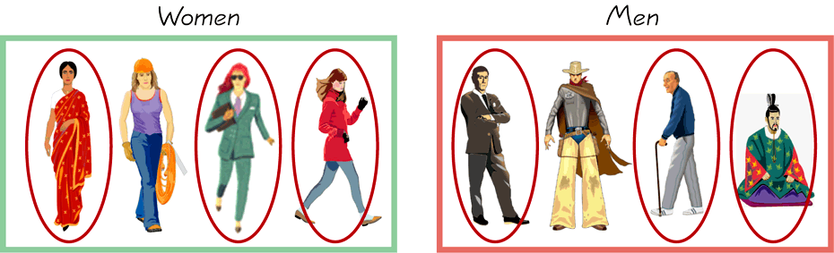
STRATIFIED SAMPLING…….
Draw a sample from each stratum

Slide 47
CLUSTER SAMPLING
Cluster sampling is an example of 'two-stage sampling' .
First stage a sample of areas is chosen;
Then a sample of subjects within those areas is selected.
Population divided into clusters of homogeneous units, usually based on geographical contiguity.
Sampling units are groups rather than individuals.
A sample of such clusters is then selected.
All units from the selected clusters are studied.

Slide 48
CLUSTER SAMPLING…….
Advantages :
Cuts down on cost of preparing a sampling frame.
This can reduce travel and other administrative costs.
Disadvantages: sampling error is higher for a simple random sample of same size.

Slide 49
CLUSTER SAMPLING…….
Two types of cluster sampling methods.
One-stage sampling. All of the elements within selected clusters are included in the sample.
Two-stage sampling. A subset of elements within selected clusters are randomly selected for inclusion in the sample.

Slide 50
Difference Between Strata and Clusters
All strata are represented in the sample; but only a subset of clusters are in the sample.
With stratified sampling, the best survey results occur when elements within strata are internally homogeneous.
However, with cluster sampling, the best results occur when elements within clusters are internally heterogeneous

Slide 51
MULTISTAGE SAMPLING
Complex form of cluster sampling in which two or more levels of units are embedded one in the other.
First stage, random number of districts chosen in all
states.
Followed by random number of talukas, villages.
Then third stage units will be houses.
All ultimate units (houses, for instance) selected at last step are surveyed.

Slide 52
Part B - SAPs

Slide 53
Learning objectives

Slide 54
Learning Objectives
Aim:
To understand the approach and layout of a statistical analysis plan (SAP), and how this relates to research objectives and study design.
Learning objectives:
To learn about the importance of a statistical analysis plan in research studies.
The benefits of pre-specifying analyses.
When SAPs are required and when merely a good idea.
To learn about the important elements of a SAP
Example analysis plans to be discussed.
To enable students to develop their own analysis plans for their projects (practical session)

Slide 55
What is a SAP?

Slide 56
Statistical Analysis Plan
A SAP is a document that outlines – to great detail – the statistical analyses that will be conducted for the study.
Sometimes just a section in the study protocol.
Most commonly a document on its own.
It should be written soon after the completion of the protocol and after perhaps a first draft of the case report forms (CRF). Needs to be done BEFORE blind breaking / first look at data.
Written by a statistician in consultation with the study investigators.
Approved / signed by statistician(s), chief and principal investigators.
Typically used in clinical trials, less common in observational studies.

Slide 57
Statistical Analysis Plan
The SAP pre-specifies:
What statistical analyses will be done.
Which are the primary and which the secondary objectives.
Which variables are (i) outcomes, (ii) exposures, (iii) covariates for each objective.
What is the analysis population (e.g. ITT, ATP).
How these analyses will be done.
Type of models / tests used.
How missing data are dealt with and rules for excluding data for specific analyses.
Which software will be used.
How results will be presented.
Table & figure shells / mock-ups.

Slide 58
Why pre-specify statistical analyses?

Slide 59
Pre-specified analyses
Reduce the degrees of freedom at the analysis stage.
Reduce p-hacking / data dredging / multiple testing / selective reporting issues.
Very easy to fool others (whether on purpose or not) & yourself.
Critical review of the study and CRF design.
Can identify issues early in the research process.
Protocol & CRFs can be amended if needed.
Sometimes too late at this stage if study already recruiting while SAP is still being developed.
Timely production of the study report since much of the analysis code, table & figure shells are already ready.
Part of the study audit trail.

Slide 60
When is a SAP required?

Slide 61
Statistical Analysis Plan
Clinical trials:
Technically not required by default.
Almost all funders and / or sponsors will insist on a SAP.
Regulatory agencies can require to see the SAP and even computer code (e.g. for more complicated novel or adaptive designs).
Clinical trial registries require some details of planned statistical analyses but typically do not explicitly require a SAP as such. https://www.who.int/ictrp/network/trds/en/
Other studies:
Often a good idea – though will be a less formal document than for RCTs.
For exploratory / hypothesis generating / data mining studies a SAP may be more limiting than useful.

Slide 62
What should a SAP contain?

Slide 63
Contents / structure of a SAP
Authors, version, date.
Recap / summary of study design & research question(s).
Primary & secondary study objectives
Most important aspect of any research study
PICOT (Patient / population, intervention, comparison(s), outcome(s), timing)
Data variables
Primary & secondary outcomes – both for efficacy & safety in RCTs
Exposures
Covariates to be adjusted for or stratified by
Definitions of variables (measurement, data transformations etc.)
Data inclusion / exclusion criteria (per analysis if needed)
Missing variables – how this will be dealt with
Statistical model / tests specifications
Statistical summaries that will be reported
Model selection process
Level to be used for statistical tests, confidence or credible intervals
Level for clinical relevance
Model diagnostics
Sub-group analyses
Multiple testing adjustments
Sample size
Table & figure shells / mock-ups
Software packages & routines that will be used

Slide 64
Contents / structure of a SAP
Comply with international guidelines for protocols & reporting – EQUATOR NETWORK – and statistical best practices
EQUATOR NETWORK
SPIRIT (RCTs – protocols & SAPs)
CONSORT (RCTs - reporting)
STROBE (observational studies)
PRISMA (systematic reviews)
…
Statistical best practices
Royal Statistical Society – Code of conduct
American Statistical Association guidelines – Ethical guidelines
ATOM (https://doi.org/10.1080/00031305.2019.1583913)
Regulator guidelines
ICH GCP, ICH E9 (stats), FDA, EMA guidelines (if applicable)

Slide 65
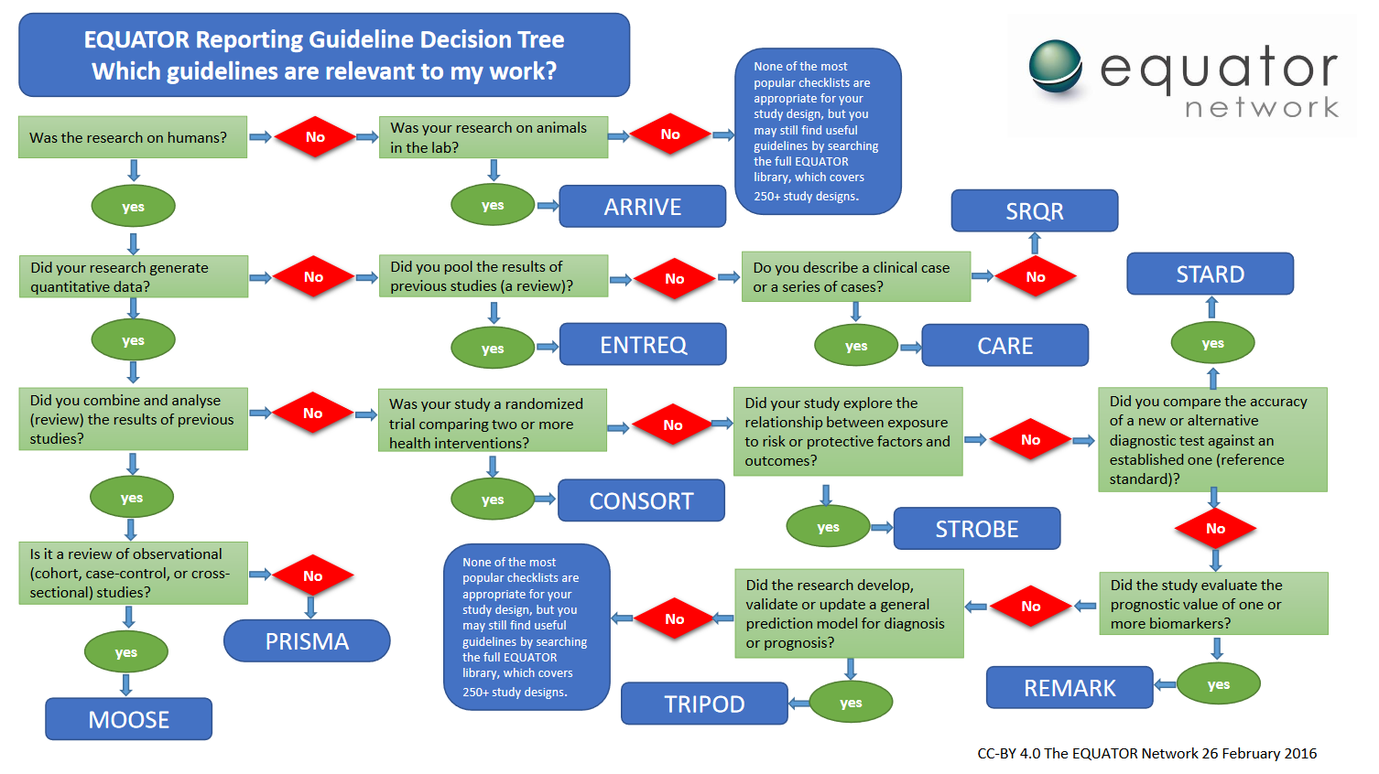
Contents / structure of a SAP

Slide 66
Recommendations

Slide 67
Recommendations
Keep audit trail
Dates of protocol & SAP approvals (for each version), when study recruitment started & finished, when the blind was broken
List and explain, in the SAP, from the protocol analysis summary section.
List and explain, in the final study report, any deviation of the actual analysis from the SAP
Review / update the SAP when the blind is broken / before the analysis begins.

Slide 68
Example

Slide 69
Supporting documents

Slide 70
Supporting documents
ICH E9 guidelines https://www.ich.org/fileadmin/Public_Web_Site/ICH_Products/Guidelines/Efficacy/E9/Step4/E9_Guideline.pdf
RSS code of conduct http://www.rss.org.uk/Images/PDF/join-us/RSS-Code-of-Conduct-2014.pdf
ASA ethical guidelines https://www.amstat.org/asa/files/pdfs/EthicalGuidelines.pdf
Example SAPs (for practical)

Slide 71
Summary diagram

Slide 72
Supporting documents
Research question
Study design / protocol
SAP
CRFs
Data
Analysis
Study report / publication

